Slide 1
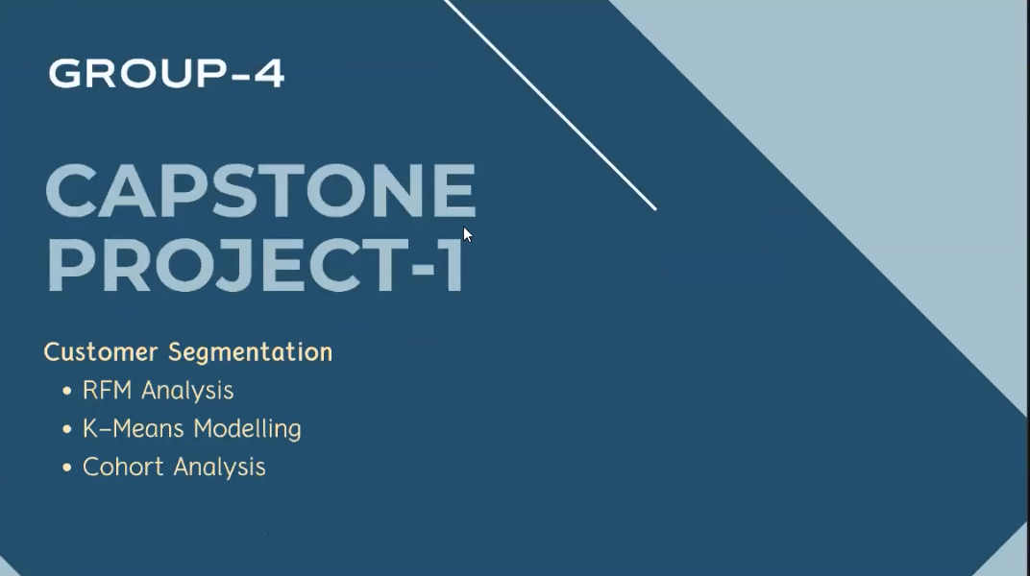

Slide 2
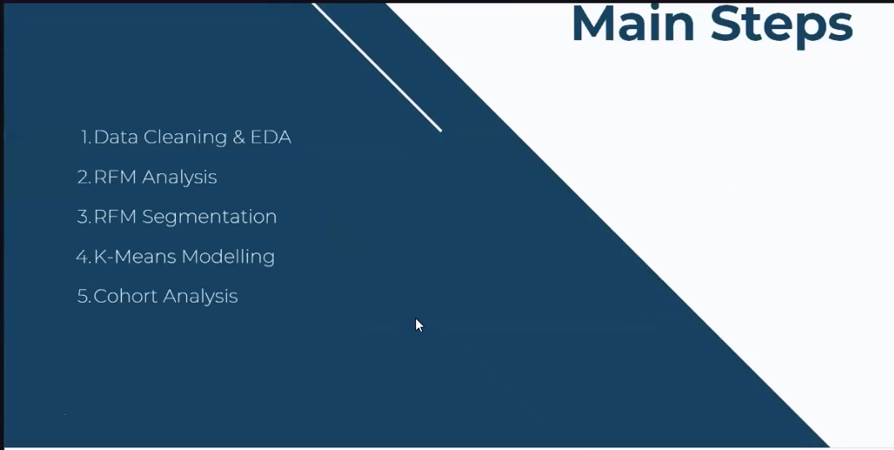

Slide 3
Determines
This is a transnational data set which contains all the transactions occurring between 01/12/2010 and 09/12/2011 for a UK-based and registered non-store online retail. The company mainly sells unique all-occasion gifts. Many customers of the company are wholesalers.
Feature Information:
InvoiceNo: Invoice number. Nominal, a 6-digit integral number uniquely assigned to each transaction. If this code starts with letter 'c', it indicates a cancellation. StockCode: Product (item) code. Nominal, a 5-digit integral number uniquely assigned to each distinct product. Description: Product (item) name. Nominal. Quantity: The quantities of each product (item) per transaction. Numeric. InvoiceDate: Invoice Date and time. Numeric, the day and time when each transaction was generated. UnitPrice: Unit price. Numeric, Product price per unit in sterling. CustomerID: Customer number. Nominal, a 5-digit integral number uniquely assigned to each customer. Country: Country name. Nominal, the name of the country where each customer resides.

Slide 4
Data Cleaning & Exploratory Data Analysis

Slide 5
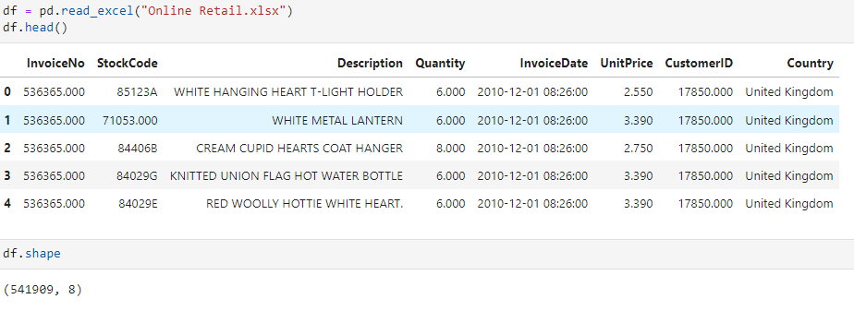
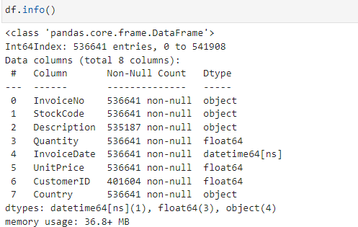
1. Data Cleaning & Exploratory Data Analysis

Slide 6
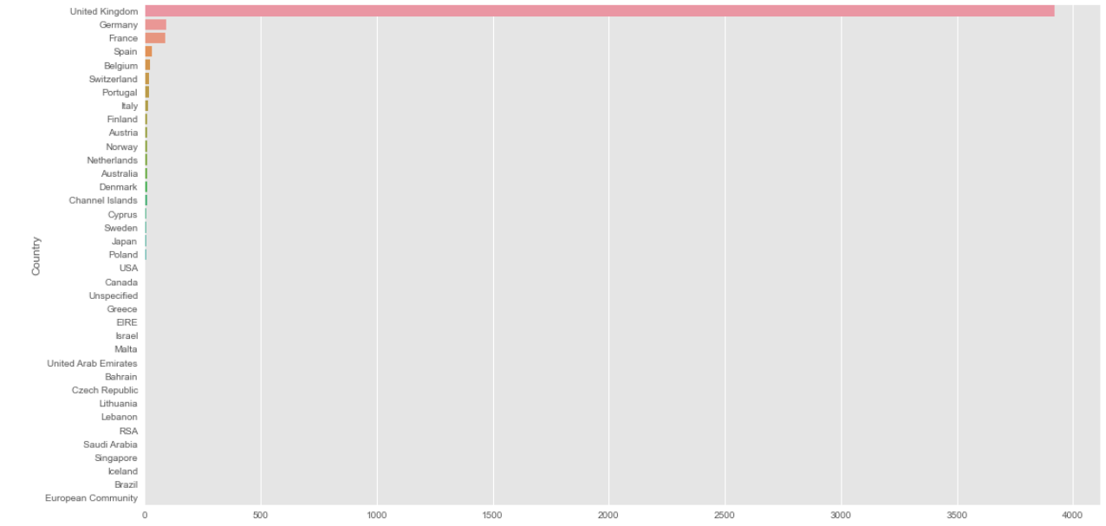
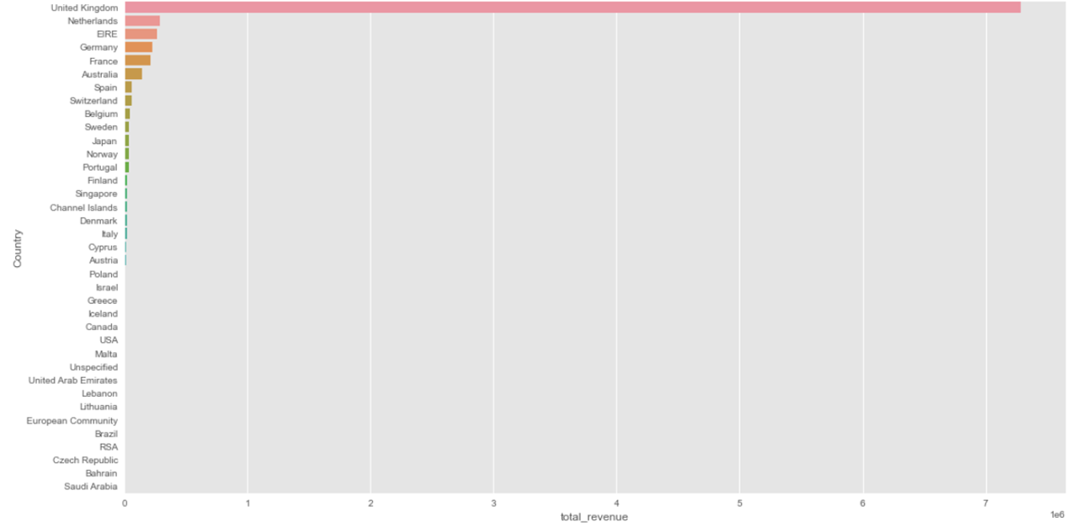
Now, let's the number of customers per Country and let's we are Visualize total revenue per country
The UK not only has the most sales revenue, but also the most customers. Since the majority of this data set contains orders from the UK, we can explore the UK market further by finding out what products the customers buy together and any other buying behaviors to improve our sales and targeting strategy.

Slide 7
RFM Analysis

Slide 8
RFM Analysis
RFM (Recency, Frequency, Monetary) Analysis is a customer segmentation technique for analyzing customer value based on past buying behavior. RFM analysis was first used by the direct mail industry more than four decades ago, yet it is still an effective way to optimize your marketing.
RECENCY (R): Time since last purchase
FREQUENCY (F): Total number of purchases
MONETARY VALUE (M): Total monetary value

Slide 9
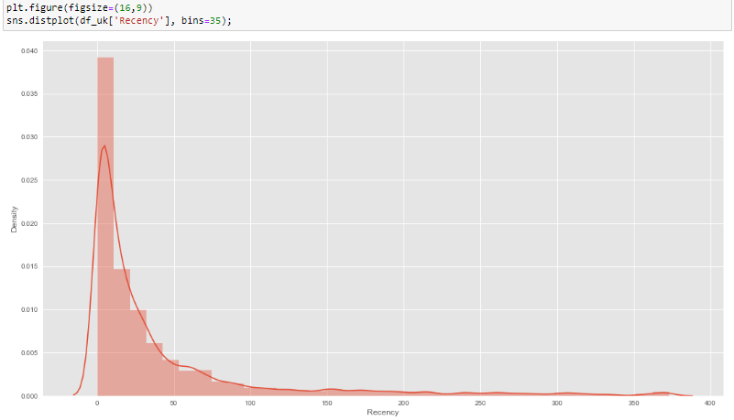
RECENCY ( R ) : Days since last purchase

Slide 10
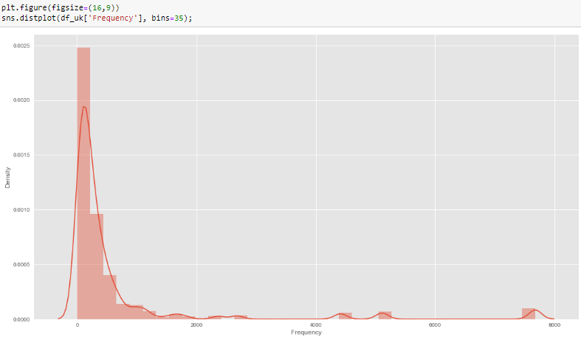
FREQUENCY (F): Number of purchases

Slide 11
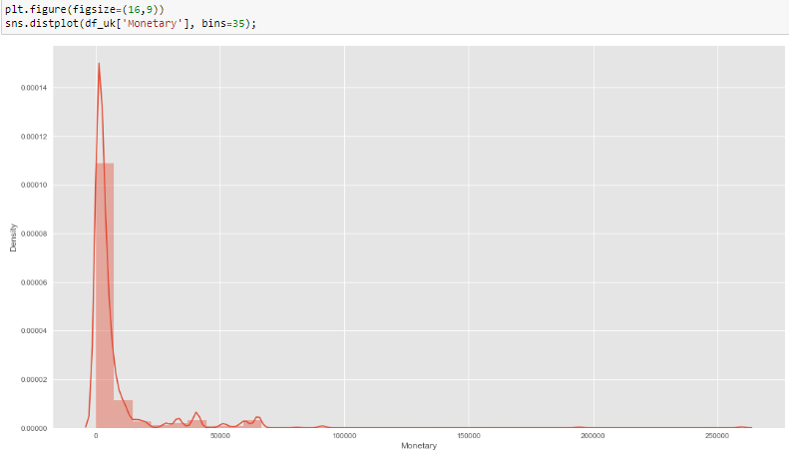
Monetary ( M ): Total amount of money spent

Slide 12
Customer Segmentation with RFM Scores

Slide 13
Calculate RFM Scoring
The simplest way to create customer segments from an RFM model is by using Quartiles. We will assign a score from 1 to 4 to each category.

Slide 14
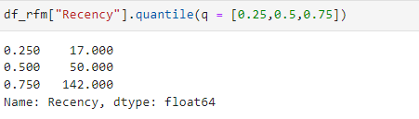
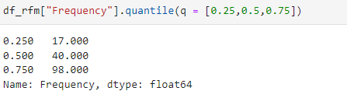
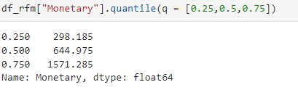
Creating the RFM Segmentation Table

Slide 15
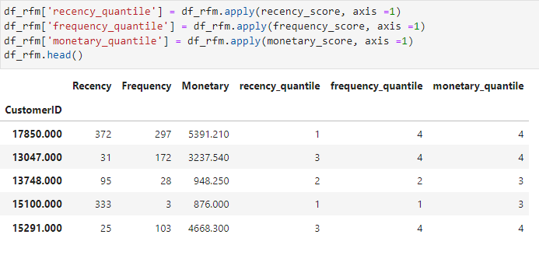
Calculate RFM Scoring
Score customers from 1 to 4 by applying the functions you have created. Also create separate score column for each value.

Slide 16
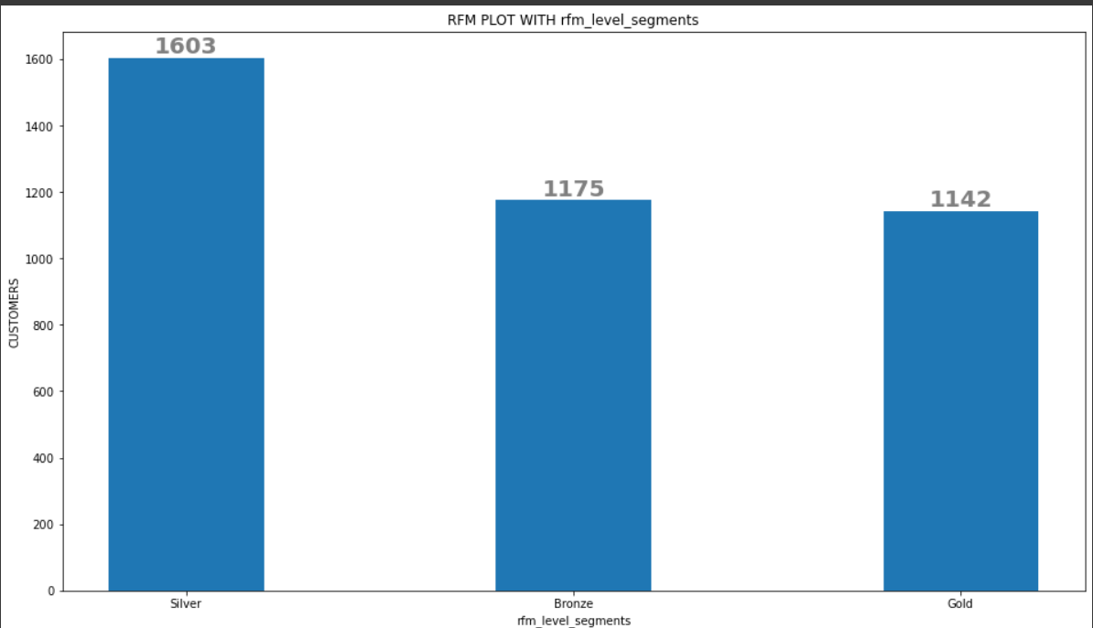
Plot RFM Segments-1

Slide 17
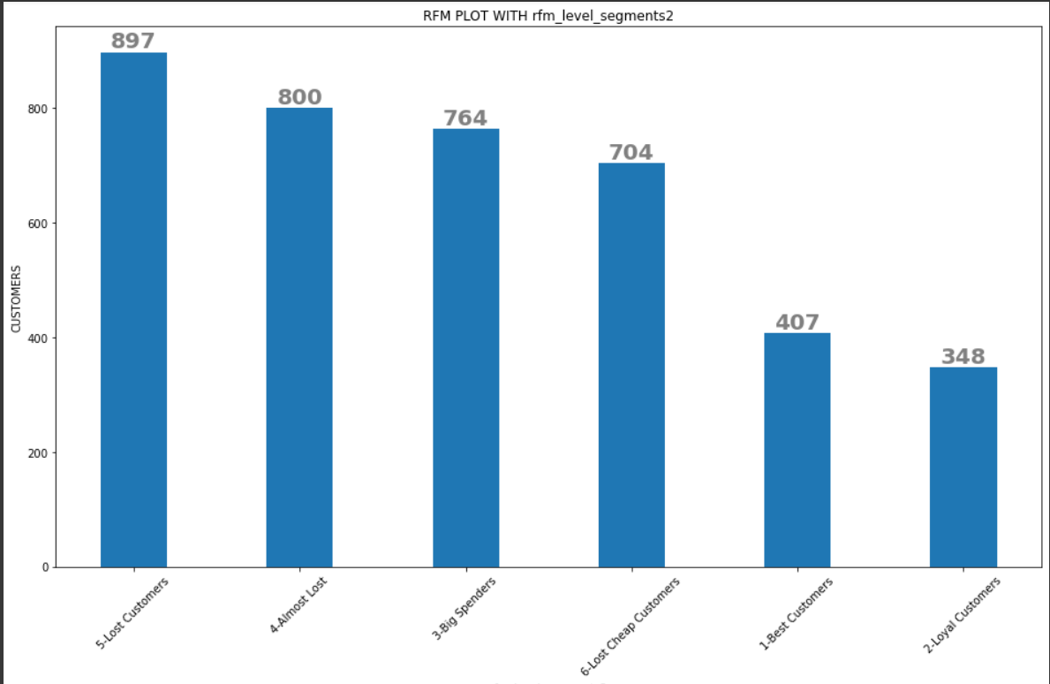
Plot RFM Segments-2

Slide 18
Applying K-Means Clustering

Slide 19
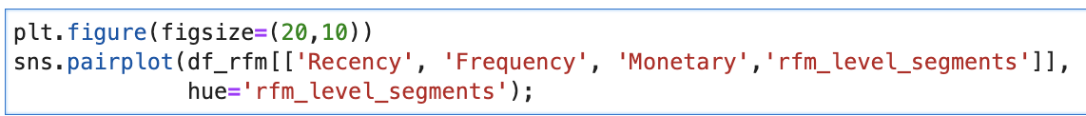
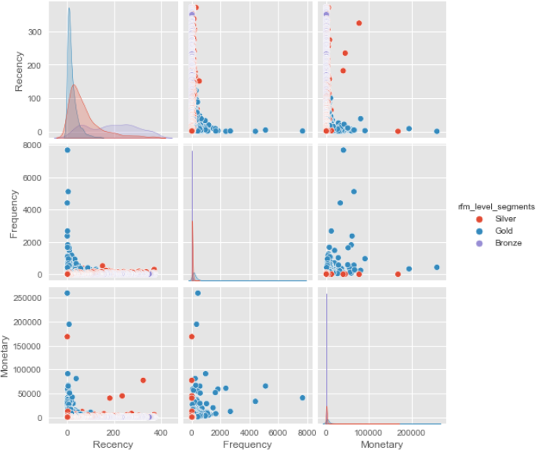
Visualize Feature Distributions
To get a better understanding of the dataset, you can costruct a scatter matrix of each of the three features in the RFM data.

Slide 20
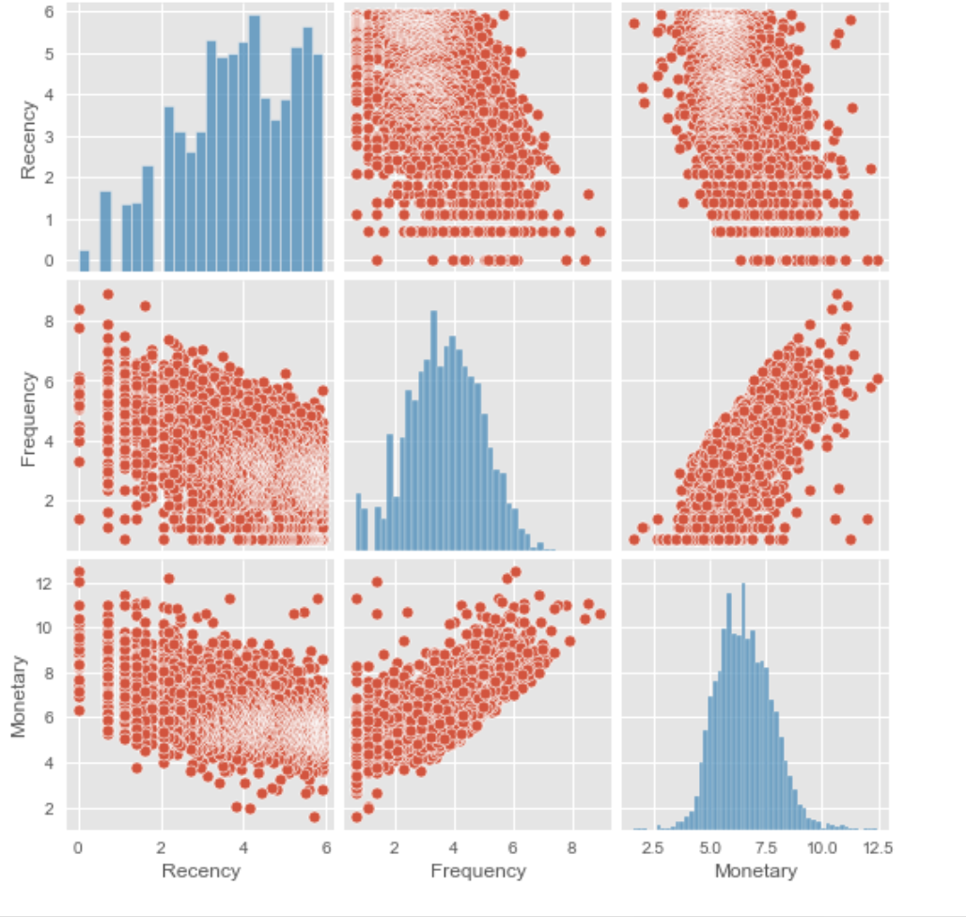
Data Normalization

Slide 21
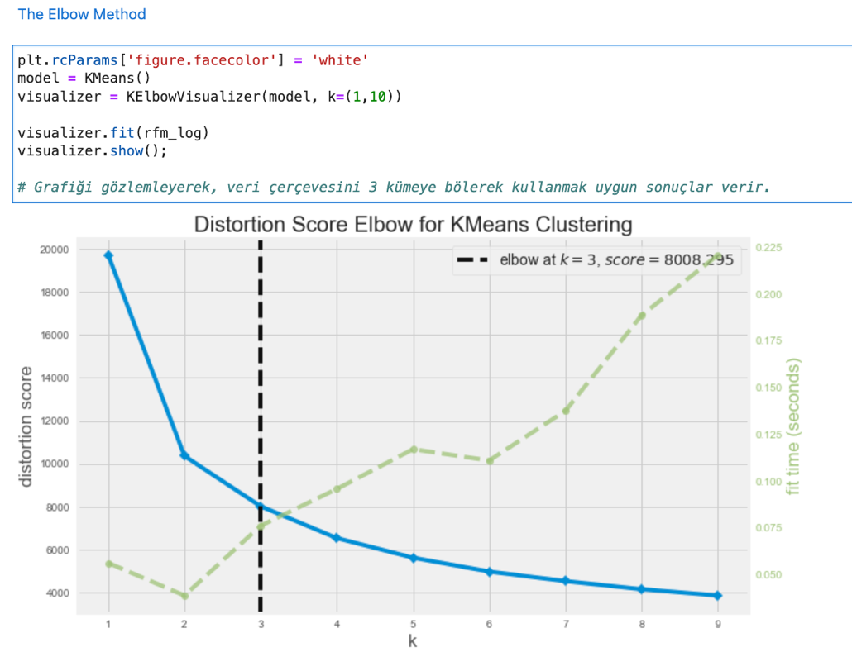
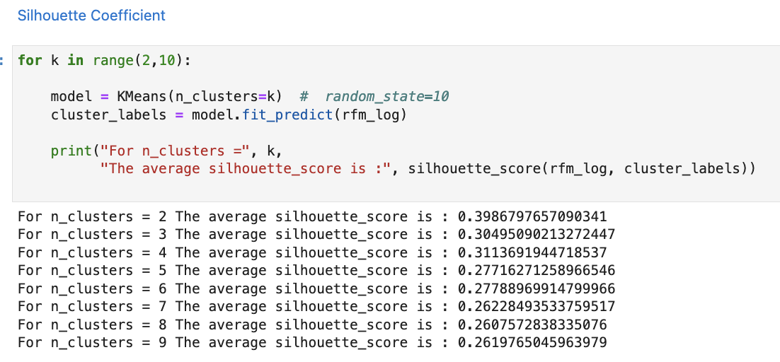
K-Means Implementation

Slide 22
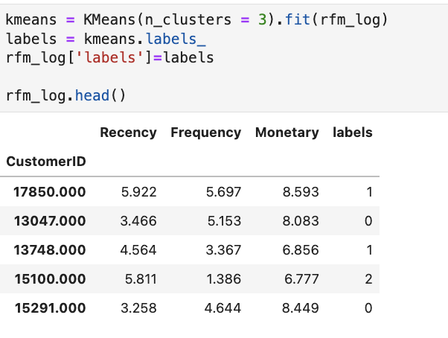
Model Fitting

Slide 23
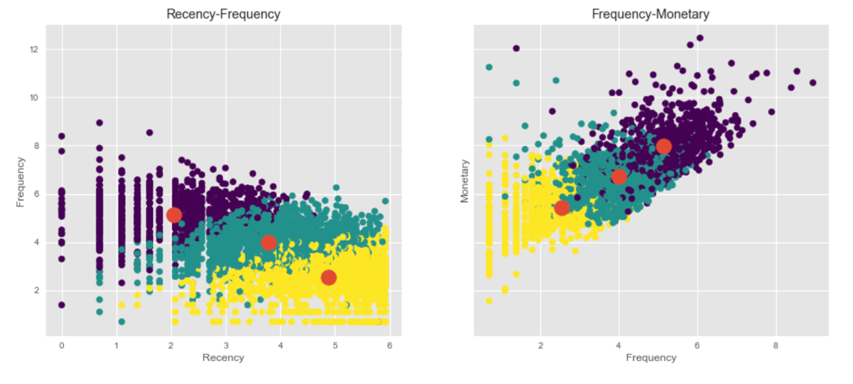
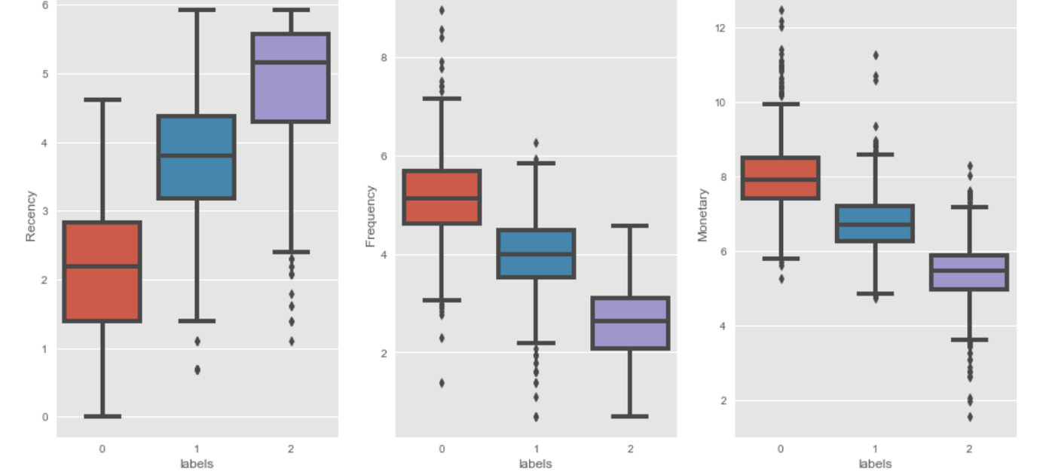
Visualize the Clusters

Slide 24
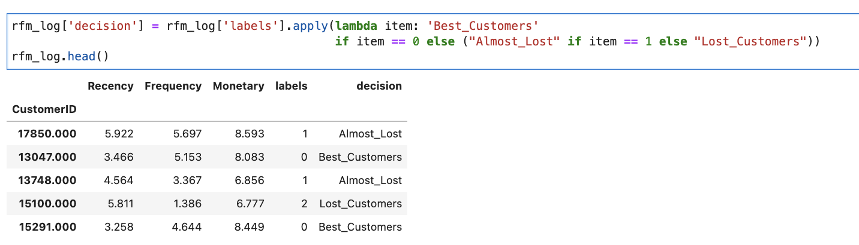
Assign the Label

Slide 25
Create Cohort & Conduct Cohort Analysis

Slide 26
Cohort Analysis
Cohort analysis is an analytics method by which these groups can be tracked over time for finding key insights. This analysis can further be used to do customer segmentation and track metrics like retention, churn, and lifetime value.

Slide 27
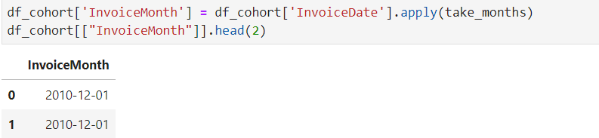
Feature Engineering
First we will create a function, which takes any date and returns the formatted date with day value as 1st of the same month and Year.

Slide 28
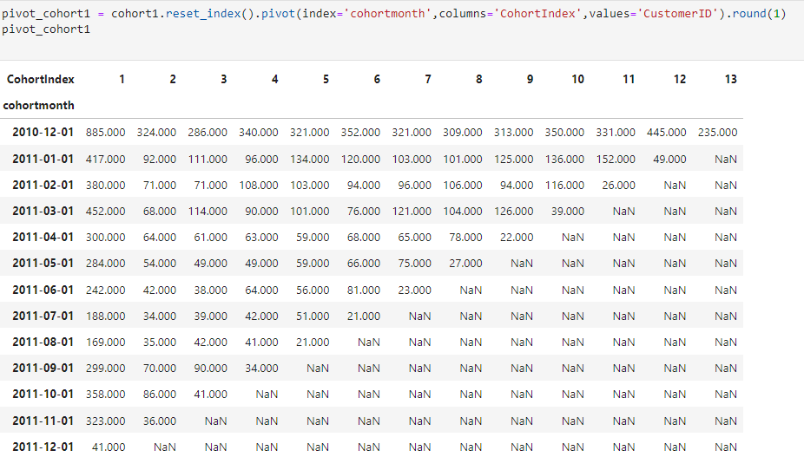
Create 1st Cohort: User number & Retention Rate
Pivot Cohort and Cohort Retention

Slide 29
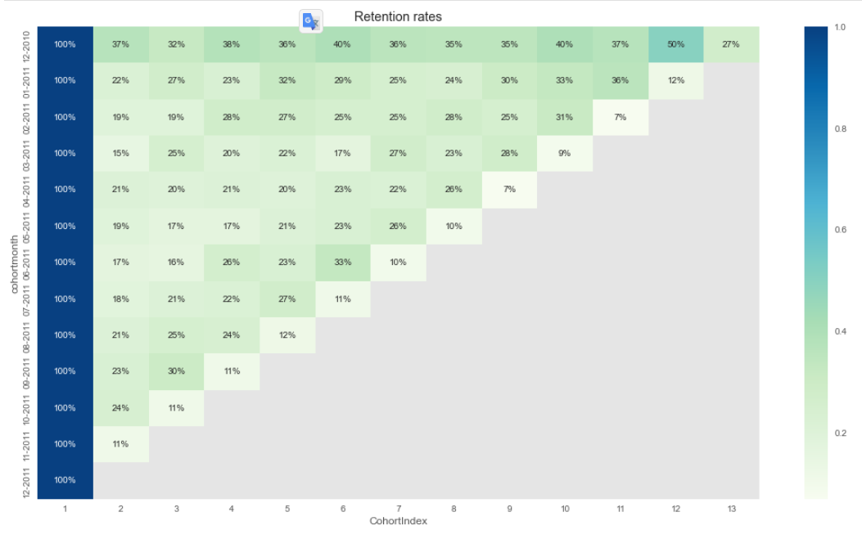
Visualize analysis of cohort 1 using seaborn and matplotlib modules
Insights :
we can see from the above chart that more users tend to purchase as time goes on.
The 12-2010 cohort is the strongest. The 02-2011 and 04-2011 cohort are the weaknest cohort.

Slide 30
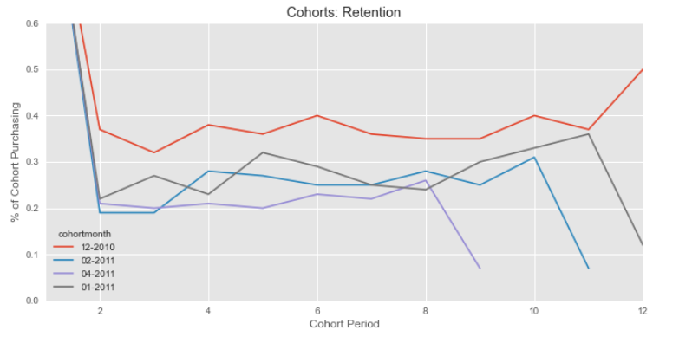
Visualize analysis of cohort 1 using seaborn and matplotlib modules

Slide 31
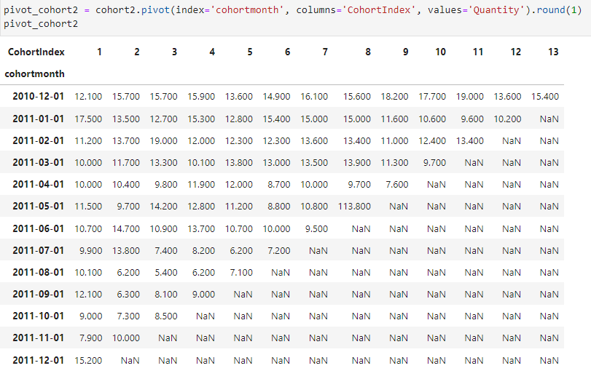
Create the 2nd Cohort: Average Quantity Sold
Pivot Cohort and Cohort Retention

Slide 32
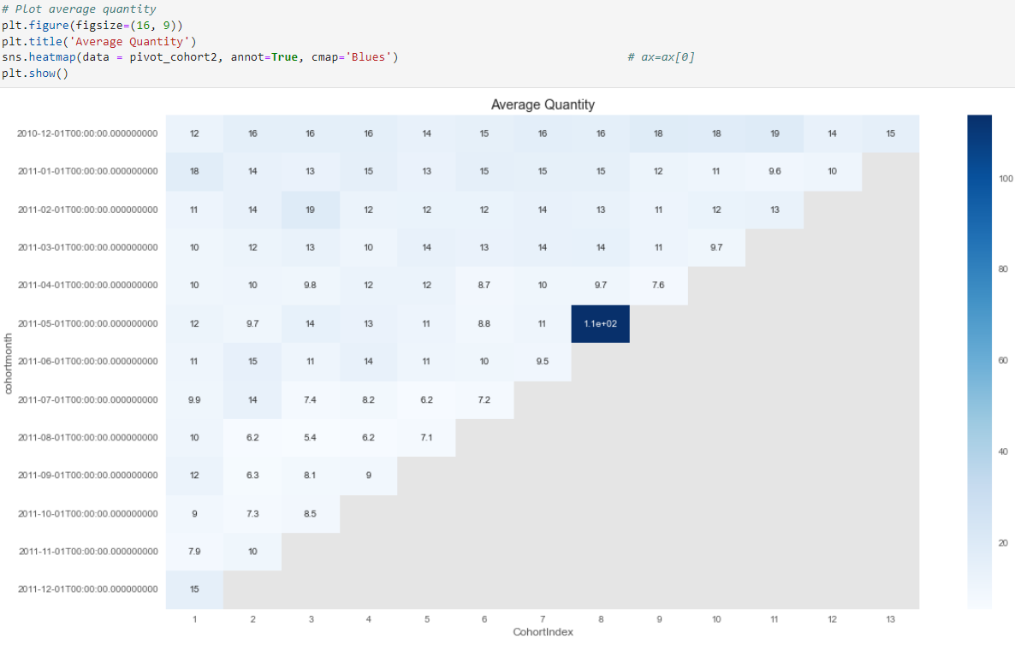
Visualize analysis of cohort 2 using seaborn and matplotlib modules

Slide 33
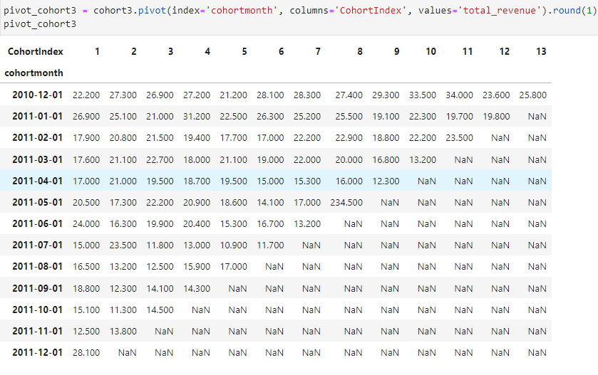
Create the 3rd Cohort: Average Sales
Pivot Cohort and Cohort Retention

Slide 34
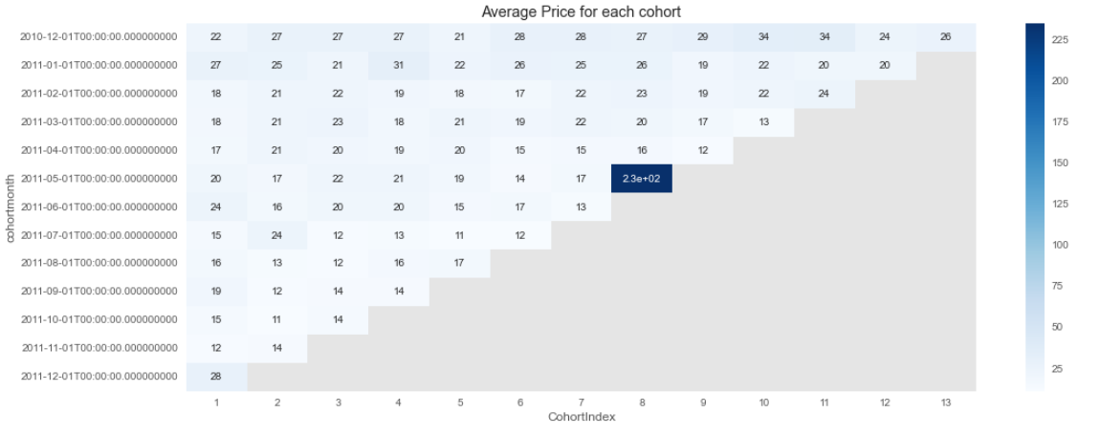
Visualize analysis of cohort 3 using seaborn and matplotlib modules

Slide 35
Thanks for listening….

